Slide 1
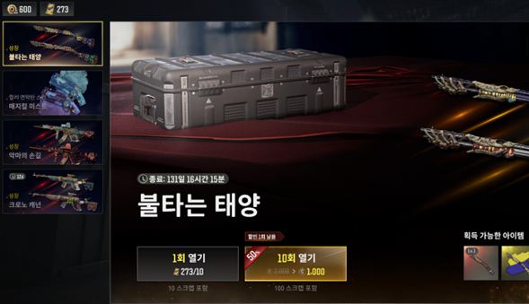


Pubg pc/console 2026 Roadmap: h. 2026 user incentive Strategy & operations
Need for increased rewards and development proposals
Need for realistic reward increases comparable to competing traffic titles
Establishment of event-exclusive gacha
Creation of independent event-exclusive gacha goods and gacha pool that do not harm the in-game economy
Providing a sense of achievement by 'collecting goods and rolling them all at once' rather than offering in a random box format
Providing continuous interest through a hero item refresh about once every six months
Development of limited-time items (smuggling coupons, hunter boxes, keys, blueprints, etc.)
Z-coins have too much freedom, making it difficult to restrict actions (therefore, important products are sold for $)
In the case of smuggling coupons, 200 Z-coins for 10 pieces, but due to high preference, it can be operated as an effective event even if distributed with the same value
Useful for impactful events at key points
e.g. 100 smuggling coupons for Mr. Taehyun (30 days) etc.
Increase in the value of enhanced goods/items
Request for review of increasing the amount of goods that have expanded usage and higher user preference due to changes in the system like BP

Slide 2



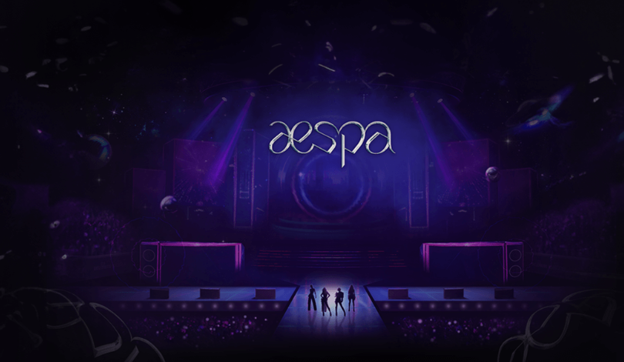
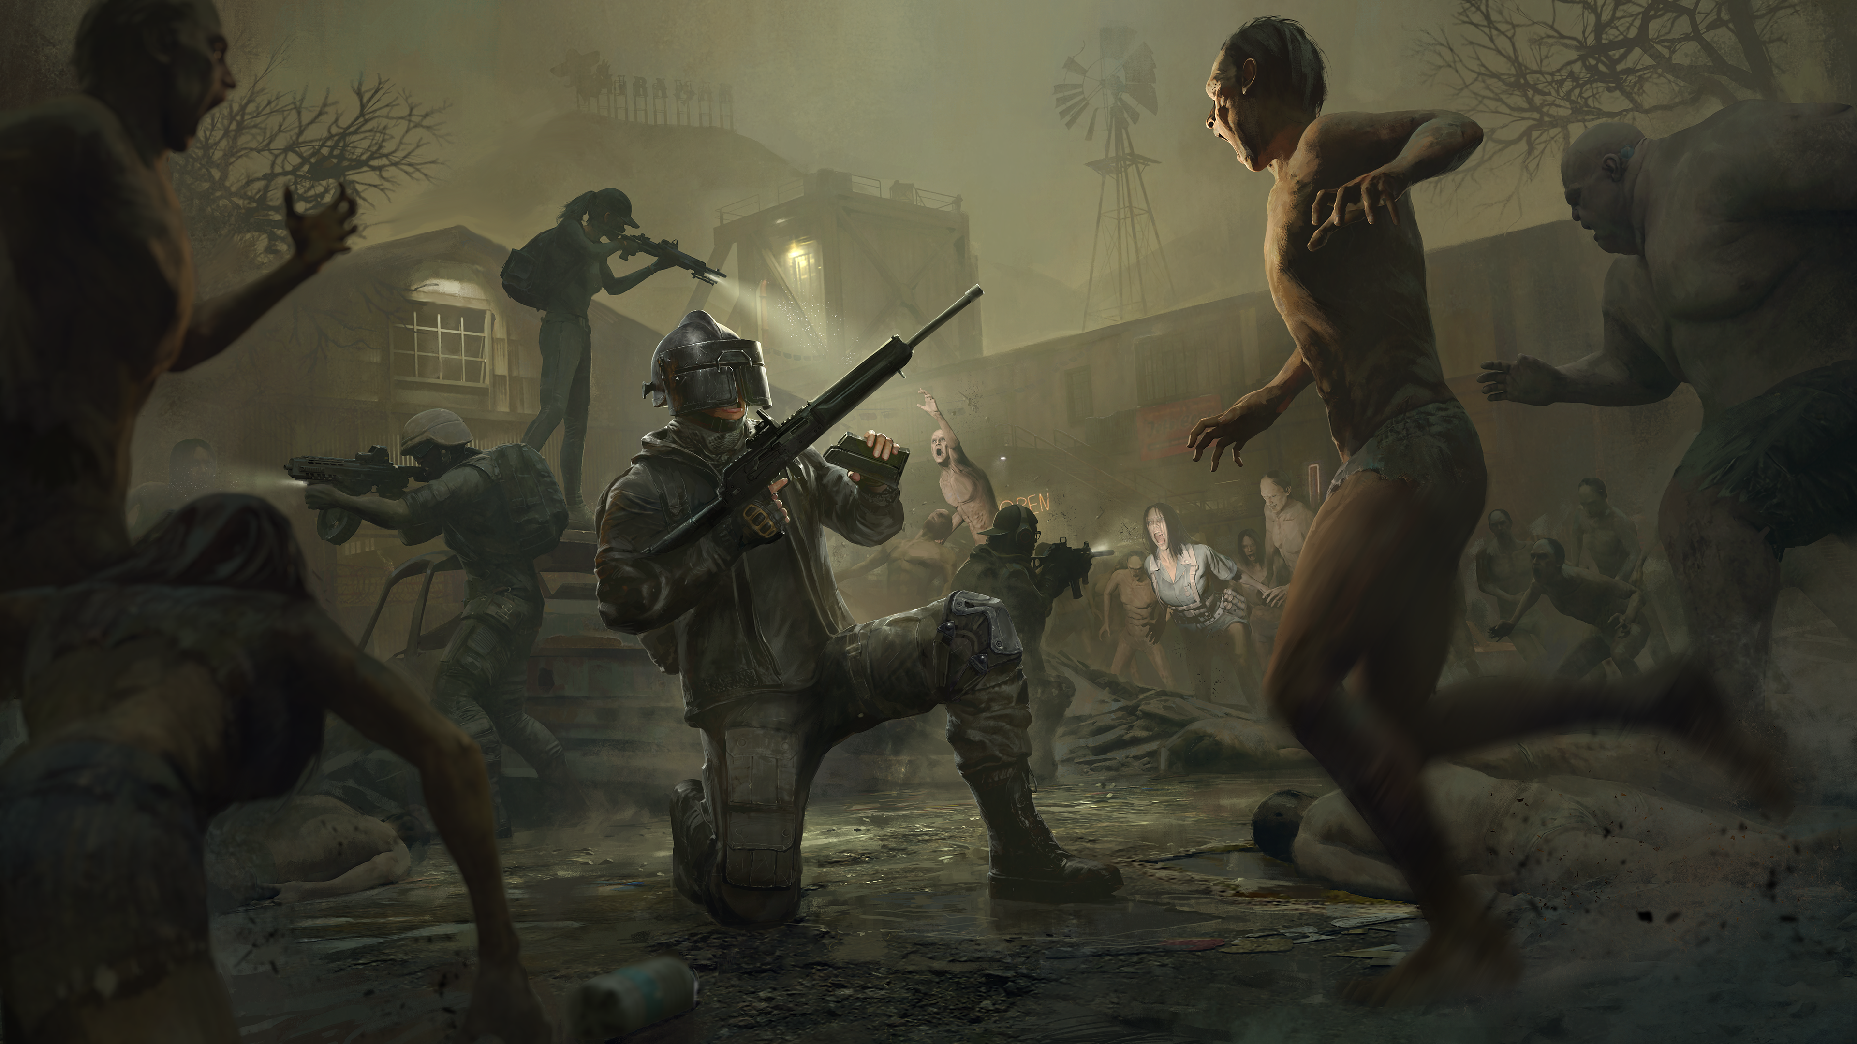

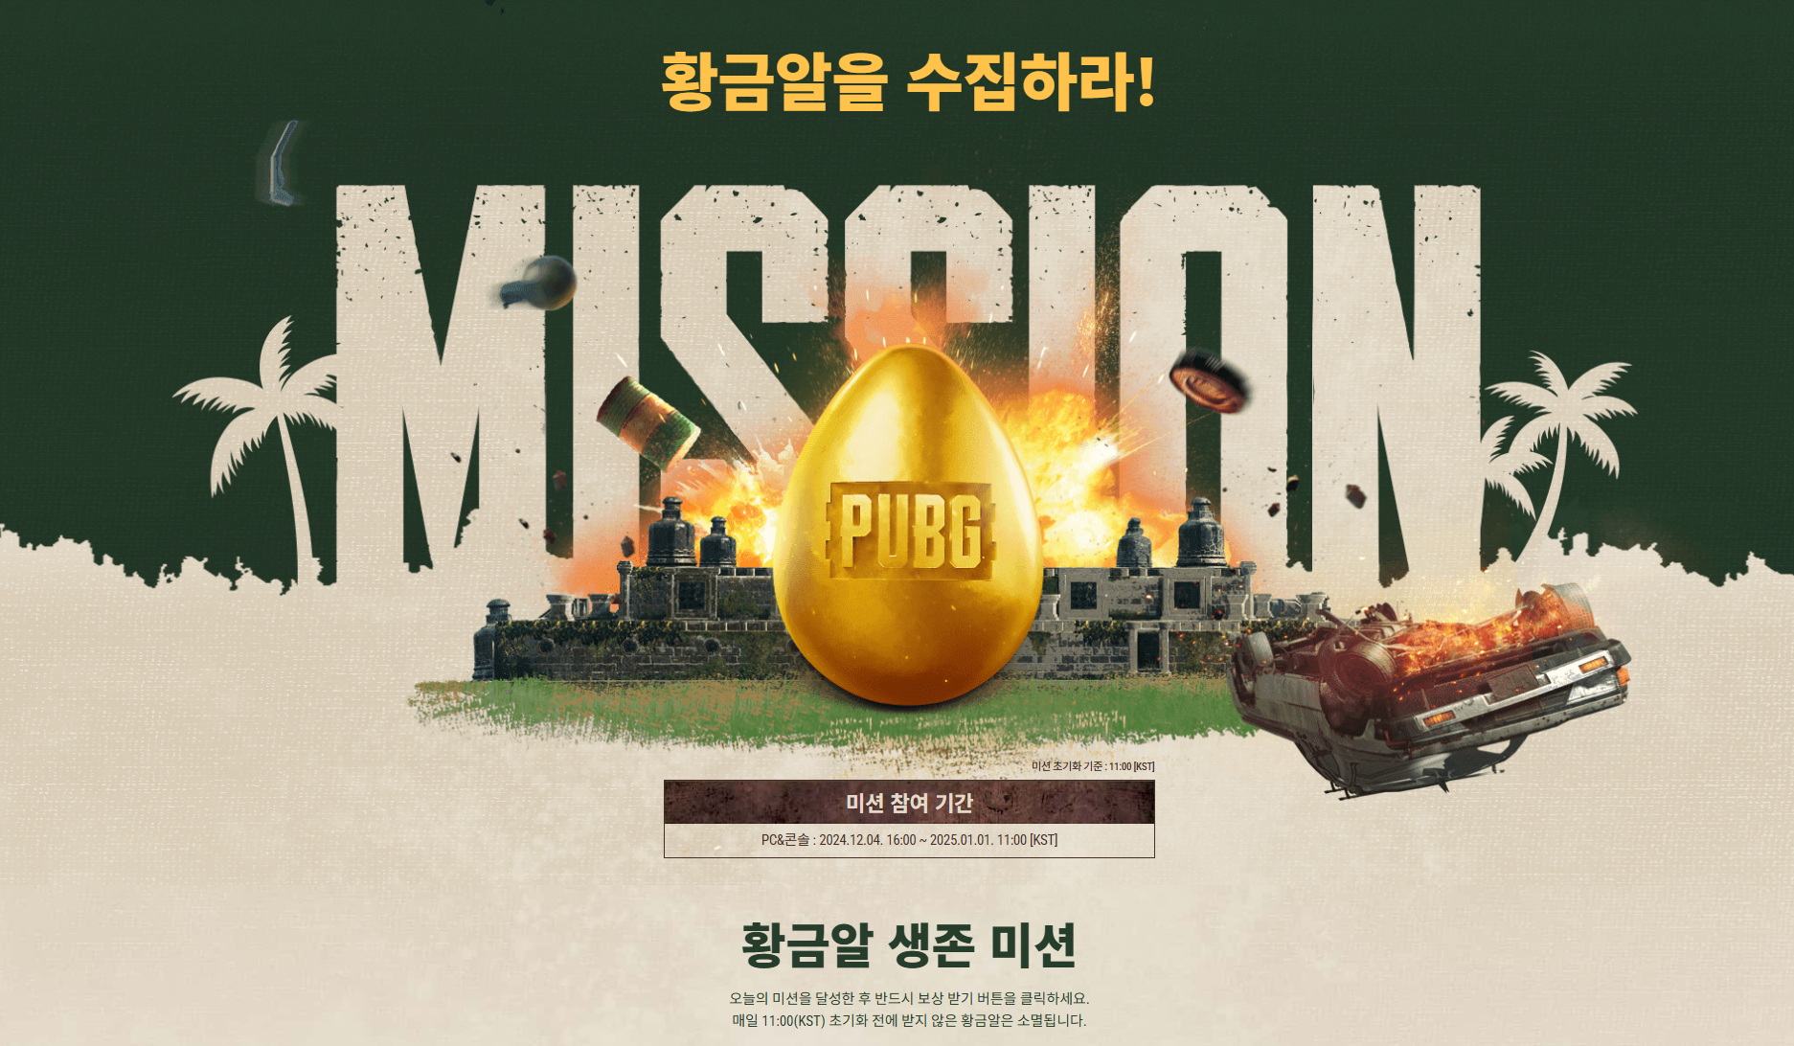
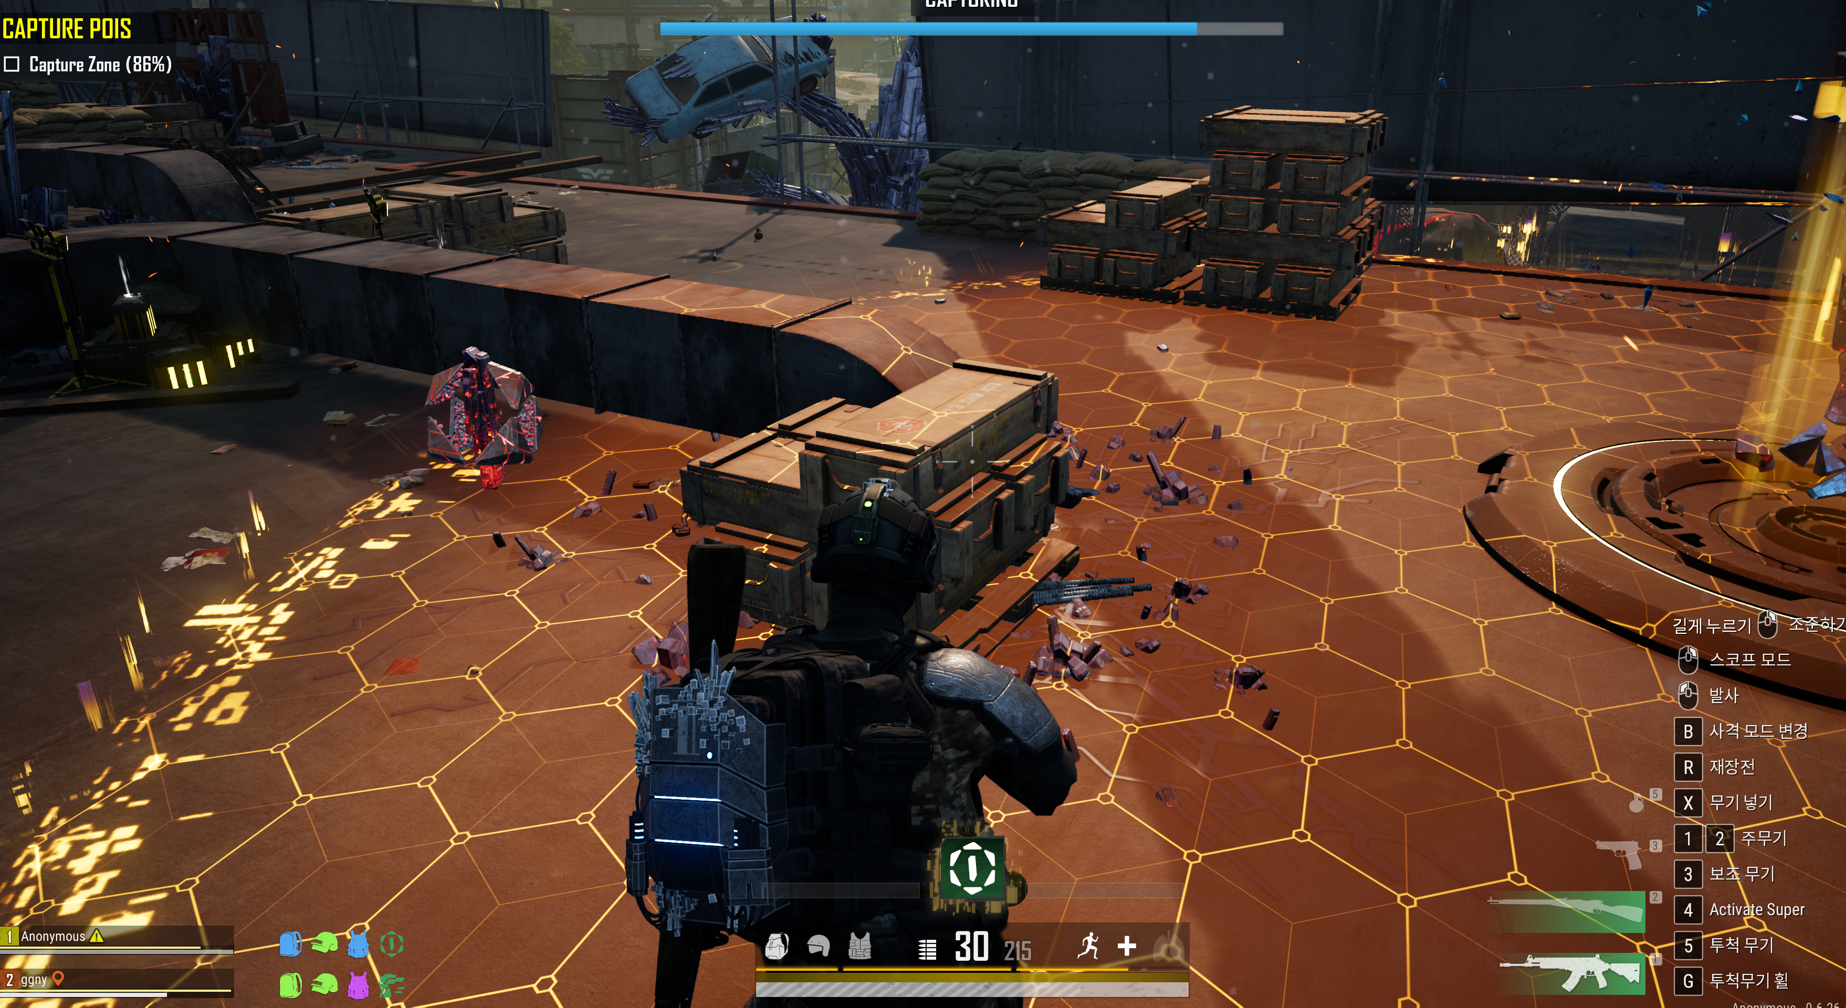


Pubg pc/console 2026 Roadmap: h. 2026 user incentive Strategy & operations
2026 event operation direction
Maximizing peak season traffic and stabilizing off-season through event scale-up based on rewards and content expansion
Response methods
Main target seasons
2026 event direction
Peak season
1Q (Lunar New Year, N anniversary, until April Fool's Day)
Increase in promotion scale based on seasonality
Expansion of event scale based on existing main seasons and core updates
March N anniversary, summer vacation in July-August, September Chuseok/Mid-Autumn Festival, large-scale world update in December
Not only simple rewards and OES expansion but also linked to exposure and participatory actions
e.g. content that induces streamer events, social challenges, esports event teasers, and on-site event inducements
Expanding the scale to attract the interest of existing/returning users and new users
Enhancing familiar fun for existing/returning users and providing return incentives
Providing fresh entry points and differentiated experiences for new users
3Q (summer vacation, Chuseok/Mid-Autumn Festival)
4Q year-end (large-scale world update in December)
Off-season
2Q (spring season after school starts in April-May)
Placement of new modes and focused promotions
Placing newly developed Co-dev modes during off-season timing to defend traffic and enhance user immersion
e.g. Binary Spot, Heist Royale, etc. prominently exposing and focusing on new modes as the main feature of the month
Binary Spot
Need for content enhancement and linked events to maintain stable off-season
Designing a defense strategy that moves away from the anniversary-centered structure, continuing from March to the second quarter (same after September Chuseok)
Actively injecting rewards that can be used for promotions along with the placement of content such as new modes to attempt traffic defense
4Q (between Chuseok in October-November and year-end)
Heist Royale (Payday)

